Slide 1
Mini project 3 data science & ai
Mariel Yap

Slide 2
Agenda
Part 1 – Grid Search and Multinomial Models with SF Crime
Context
EDA
Modelling
Conclusions
Part 2 – KMeans with Isotopic Composition Plutonium Batches
Context
EDA
Modelling
Conclusions
Part 3 – DBSCAN with Circles
Context
EDA
Modelling
Conclusions

Slide 3
Grid search and multinomial models
Using the San Francisco Crime Dataset

Slide 4
context
The data takes records of crime in San Francisco between the months of February and May in 2015.
Contains 18,000 records and 8 features.
Problem: Can we implement a model to predict the level of crime given the variables in the SF dataset?

Slide 5
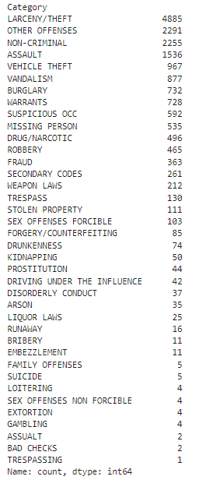
eda
Different categories of crime:
Type of crime:
Majority class: Violent Crime
Baseline accuracy: 59.31%
VIOLENT_CRIME | 10676
NOT_CRIMINAL | 3852
NON-VIOLENT | 3272

Slide 6
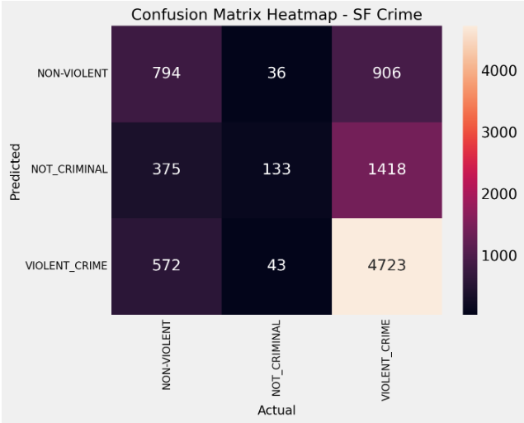
Modelling
Logistic Regression Model:
Mean Cross-Validated Accuracy on training data (5 Fold): 62.78%

Slide 7
Modelling- grid search
Hyperparameters
solver: algorithm used for optimization (relevant for multiclass)
Newton-cg - L2 only
Sag - L2 Only
lbfgs - L2 Only
liblinear
Saga
C: Regularization strengths (smaller values are stronger penalties): 0.001, 0.01, 0.1, 1, 10, 100
penalty: 'l1' - Lasso, 'l2' - Ridge
Optimum model parameters:
Solver – liblinear
C – 0.001
Penalty – L2 Ridge

Slide 8
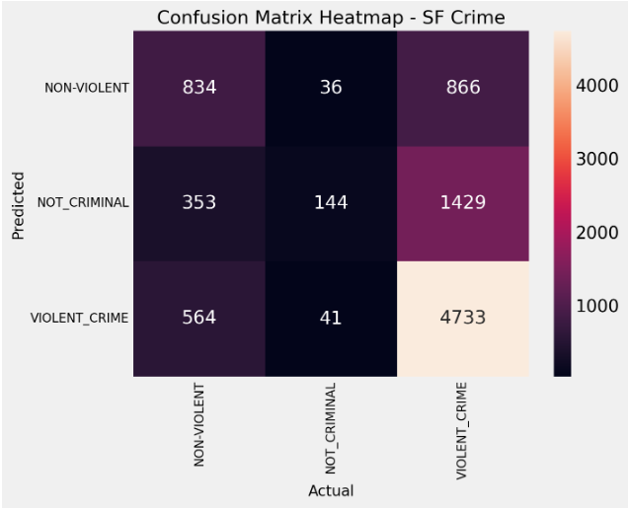
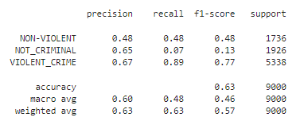
Modelling- grid search
Classification Report
Classification Accuracy (Grid Search): 63.45%

Slide 9
conclusion
The grid search model shows an improvement on the baseline accuracy by 4.15%
The grid search model shows a slight improvement on the standard logistic regression model by 0.68%.
The optimal grid search model is learning meaningful patterns from the data but there is still room for improvement.
Next steps:
Further tune other hyperparameters for logistic regression
Perform feature selection to select most relevant features
Perform undersampling on the majority class to better balance the data
Or perhaps better data need to be collected.

Slide 10
kmeans
Isotopic Composition Plutonium Batches Dataset

Slide 11
context
The data contains percentages of the isotopic composition of 45 plutonium batches.
Contains 45 records and 5 features, 4 relating to different isotopes.
Problem: Can we implement a clustering model to discover further subgroups within the plutonium data with similar criteria?

Slide 12
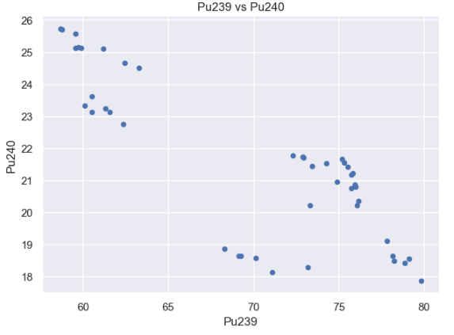
eda
There is a negative correlation between the Pu239 and Pu240 isotopes

Slide 13
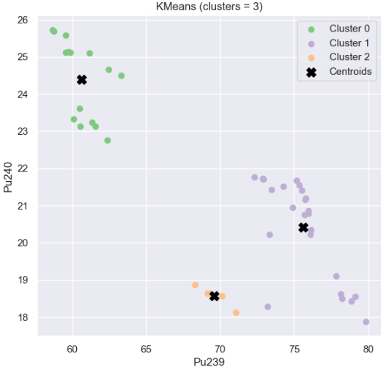
Modelling
KMeans Clustering model k = 3
Silhouette score: 0.6333

Slide 14
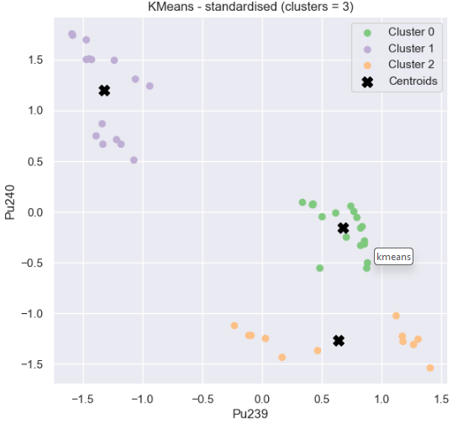
Modelling& conclusion
KMeans Clustering model k = 3
With standardised data!
Silhouette score: 0.7714
Next steps:
Explore different number of clusters using elbow method to find optimal k
Tune other hyperparameters
Consider other distance metrics for kmeans

Slide 15
dbscan
Circles Dataset

Slide 16
context
The data is taken from sklearn.datasets where we can tune the parameters to generate circles.
Contains 1000 samples.
Problem: Which is the optimal clustering model to discover clusters within the circles data?

Slide 17
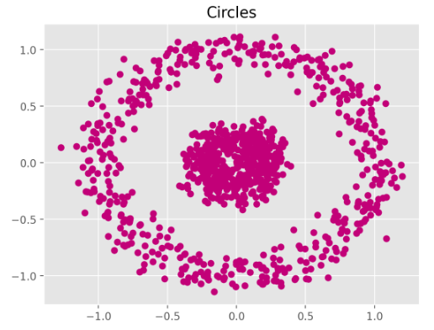
eda

Slide 18
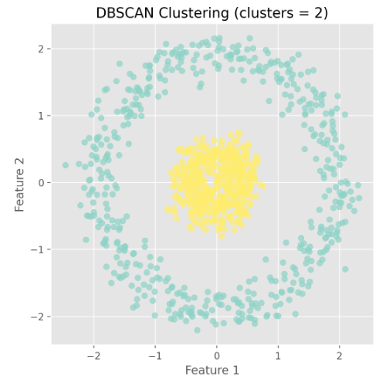
Modelling
DBSCAN Model
Homogeneity Score: 1.0 Completeness Score: 1.0
V-measure Score: 1.0
Silhouette score: 0.2378

Slide 19
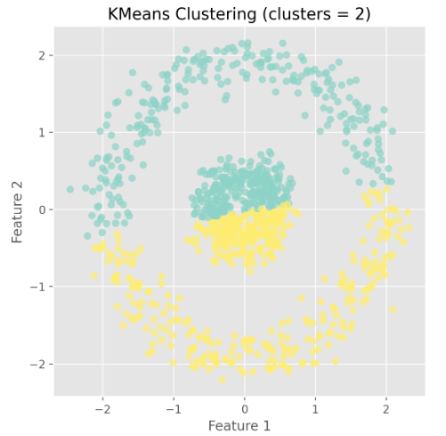
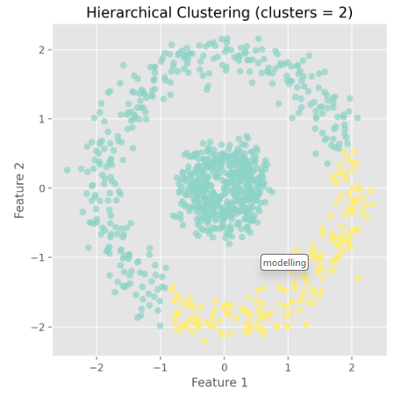
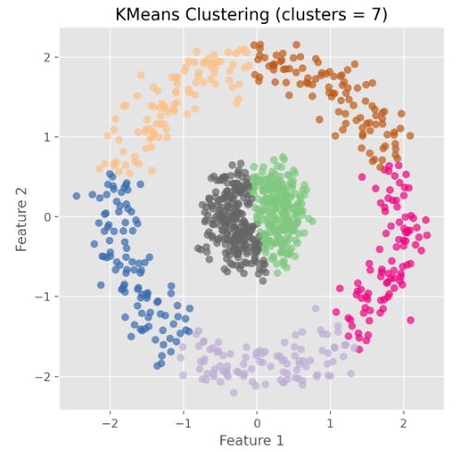
modelling & conclusion
Hierarchical Clustering
Kmeans K = 2
Kmeans K = 7
Silhouette score: 0.258
Silhouette score: 0.3808
Silhouette score: 0.4135
Conclusion:
Need to consider domain knowledge, additional metrics as well as visual inspection in addition to silhouette score when evaluating clustering models
Next steps:
Consider further tuning the hyperparameters to investigate DBSCAN silhouette score

Slide 20
THANK YOU
Mariel Yap

